Slide 1

Geometry
Unit 2, Lesson 8 Proofs – Part 2 Volume 1, pg. 116

Slide 2


Benchmarks
MA.912.GR.1.1
Prove relationships and theorems about lines and angles. Solve mathematical and real-world problems involving postulates, relationships and theorems of lines and angles.
MA.912.GLT.4.10
Judge the validity of arguments and give counterexamples to disprove statements.
volume 1, pg. 116

Slide 3
Integrated Mathematical Thinking and Reasoning Standards
MA.K12.MTR.1.1 Actively participate in effortful learning both individually and collectively.
MA.K12.MTR.2.1 Demonstrate understanding by representing problems in multiple ways.
MA.K12.MTR.4.1 Engage in discussions that reflect on the mathematical thinking of self and others.
MA.K12.MTR.5.1 Use patterns and structure to help understand and connect mathematical concepts.
MA.K12.MTR.6.1 Assess the reasonableness of solutions.
volume 1, pg. 116

Slide 4

Learning Targets
I can reflect on the mathematical thinking found in a proof.
I can reason about proofs using deductive reasoning, definitions, and postulates.
volume 1, pg. 116

Slide 5

Warm-Up
volume 1, pg. 117

Slide 6
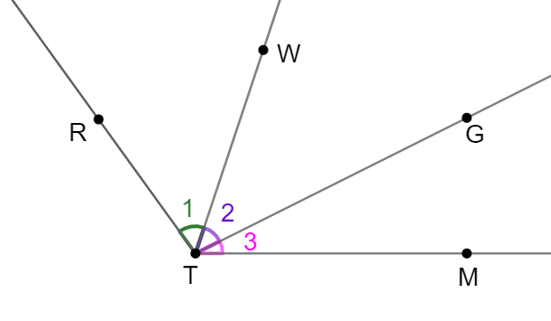

2.8.1 Warm-Up: Bell Work
Given: $m∠1=m∠3$
Prove: $∠RTG≅∠WTM$
Use the flowchart proof and the two-column proof from the previous lesson to write a paragraph proof.
volume 1, pg. 117

Slide 7

Collaboration
volume 1, pg. 117

Slide 8

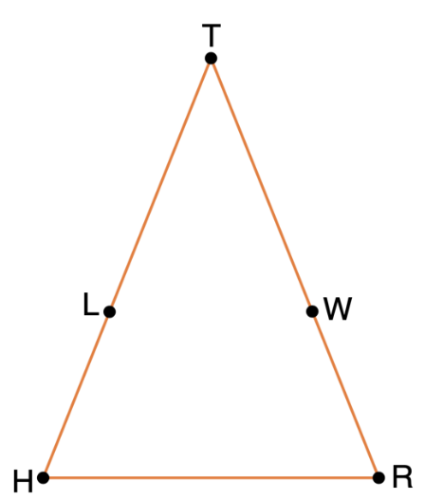
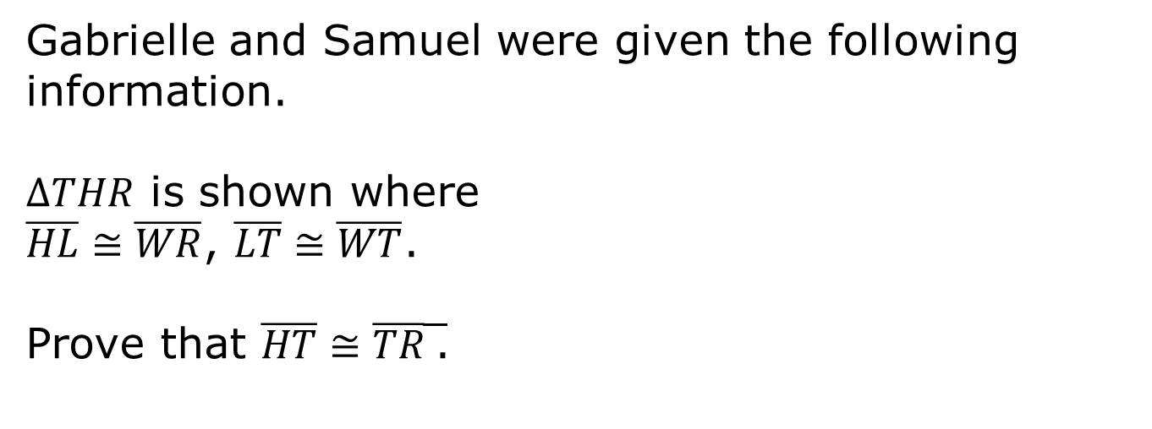
2.8.2 Collaboration: Brainstorming Before Writing a Proof
Work with your partner to complete the following.
Gabrielle and Samuel were given the following information.
$∆THR$ is shown where
$\overline{HL}≅\overline{WR}$, $\overline{LT}≅\overline{WT}$.
Prove that $\overline{HT}≅\overline{TR}$̅.
volume 1, pg. 117

Slide 9
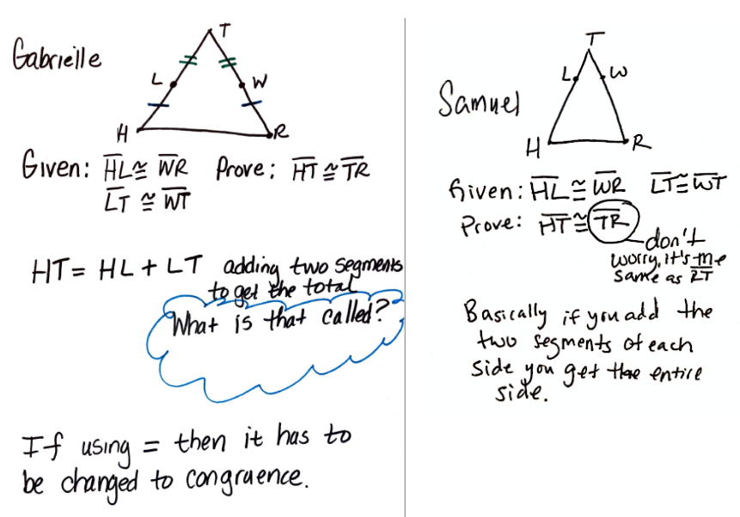
Before Gabrielle and Samuel wrote their paragraph proof, they brainstormed. Their notes are shown below.
volume 1, pg. 117

Slide 10

Why did Samuel write “Don’t worry it is the same thing as $\overline{RT}$?”
Gabrielle made some markings on the triangle she drew. What are her markings meant to show?
volume 1, pg. 118

Slide 11
Gabrielle wrote “𝐻𝑇=𝐻𝐿+𝐿𝑇,” but she could not remember what that was called. Samuel wrote “Basically if you add the two segments of each side you get the entire side.” What postulate justifies Gabrielle's statements?
If you and your partner cannot remember the name of the postulate Gabrielle and Samuel are referring to, then look through your workbook to find it.
volume 1, pg. 118

Slide 12
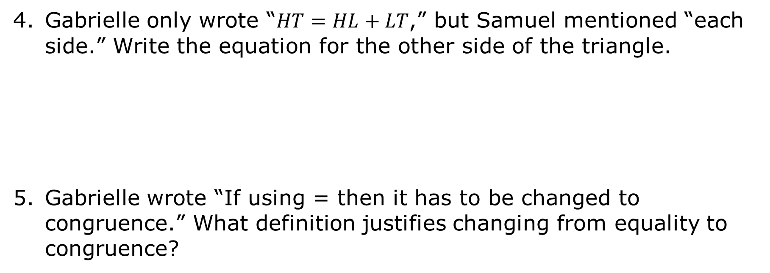
Gabrielle only wrote “$HT=HL+LT$,” but Samuel mentioned “each side.” Write the equation for the other side of the triangle.
Gabrielle wrote “If using = then it has to be changed to congruence.” What definition justifies changing from equality to congruence?
volume 1, pg. 118

Slide 13
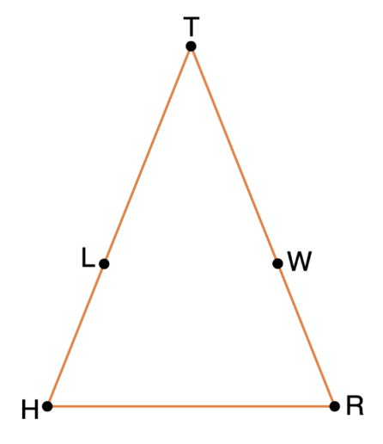

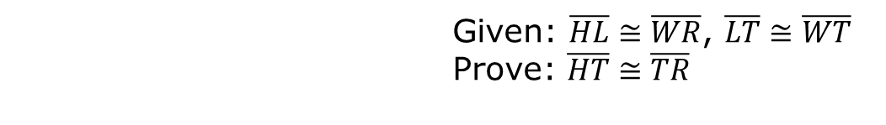
Apply the brainstorming of Gabrielle and Samuel to finish the paragraph proof. The first sentence has been written for you.
 | Given: $\overline{HL}≅\overline{WR}$, $\overline{LT}≅\overline{WT}$ Prove: $\overline{HT}≅\overline{TR}$
It is given that $\overline{HL}≅\overline{WR}$ and $\overline{LT}≅\overline{WT}$.
volume 1, pg. 118

Slide 14
Describe the most difficult part of writing the paragraph proof.
Describe how Gabrielle and Samuel’s brainstorming was helpful.
Check your proof with another group and if necessary, resolve any differences.
volume 1, pg. 119

Slide 15

Guided Instruction
volume 1, pg. 119

Slide 16
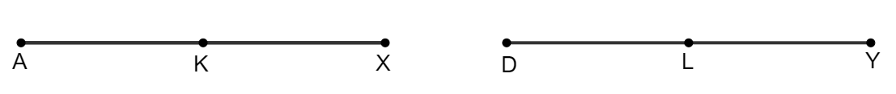
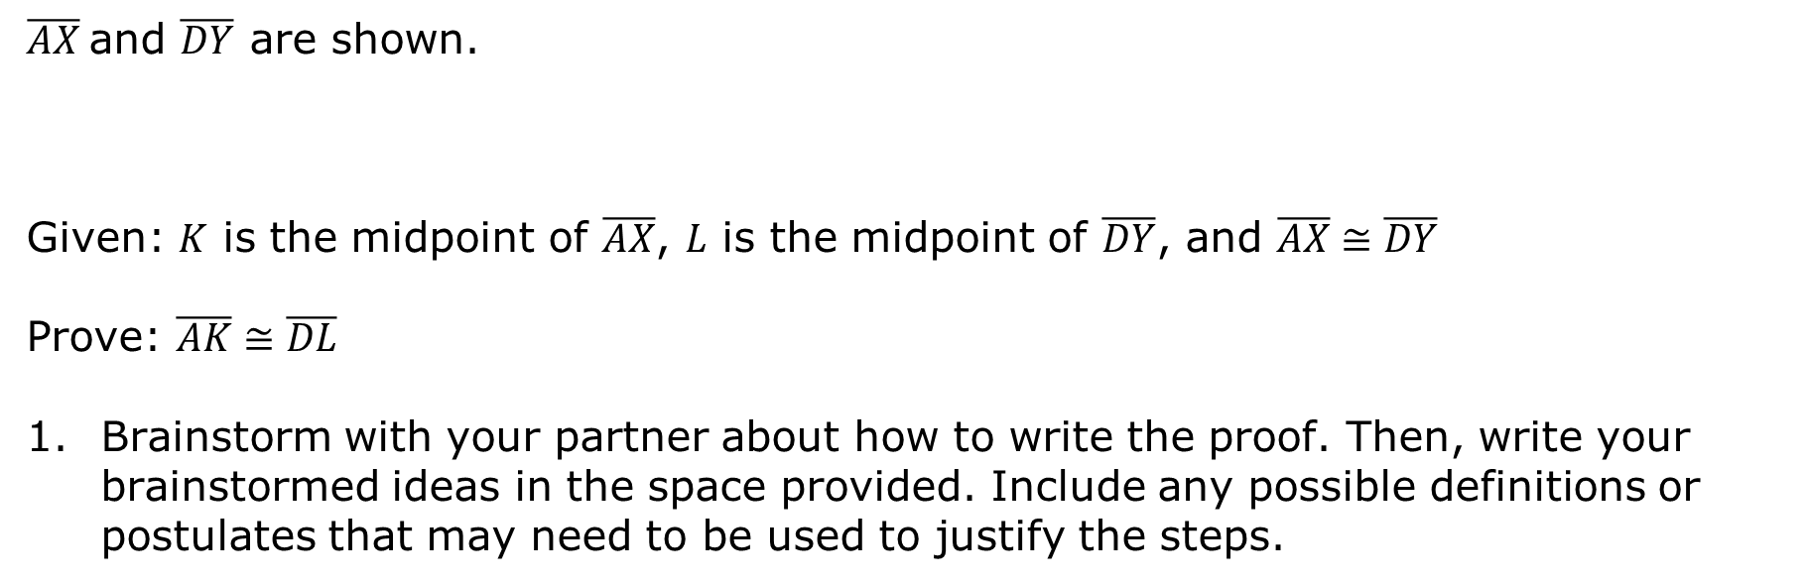
2.8.3 Guided Instruction: Flowchart Proof
$\overline{AX}$and $\overline{DY}$ are shown.
Given: $K$ is the midpoint of $\overline{AX}$, $L$ is the midpoint of $\overline{DY}$, and $\overline{AX}≅\overline{DY}$
Prove: $\overline{AK}≅\overline{DL}$
Brainstorm with your partner about how to write the proof. Then, write your brainstormed ideas in the space provided. Include any possible definitions or postulates that may need to be used to justify the steps.
volume 1, pg. 119

Slide 17
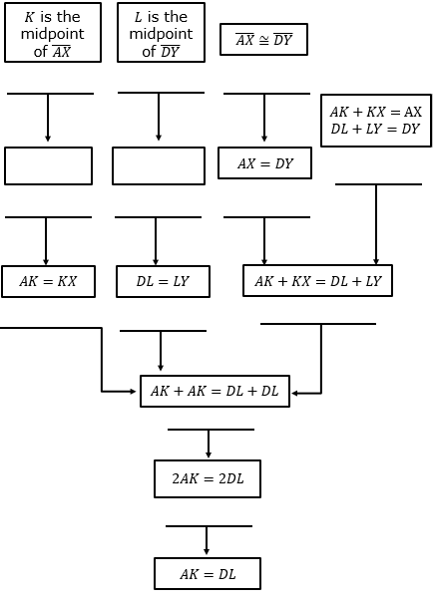
Complete the flowchart proof.
volume 1, pg. 120

Slide 18

Your Turn
volume 1, pg. 120

Slide 19
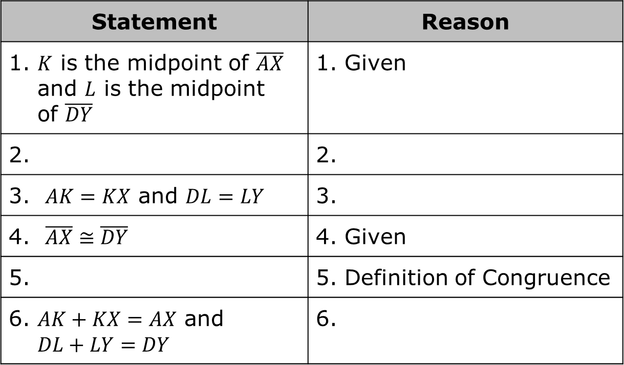
2.8.4 Your Turn!
Use the previous flowchart to complete the two-column proof.
Statement | Reason
1. $K$ is the midpoint of $\overline{AX}$ and $L$ is the midpoint of $\overline{DY}$ | 1. Given
2. | 2.
3. $AK=KX$ and $DL=LY$ | 3.
4. $\overline{AX}≅\overline{DY}$ | 4. Given
5. | 5. Definition of Congruence
6. $AK+KX=AX$ and $$DL+LY=DY$$ | 6.
volume 1, pg. 120

Slide 20
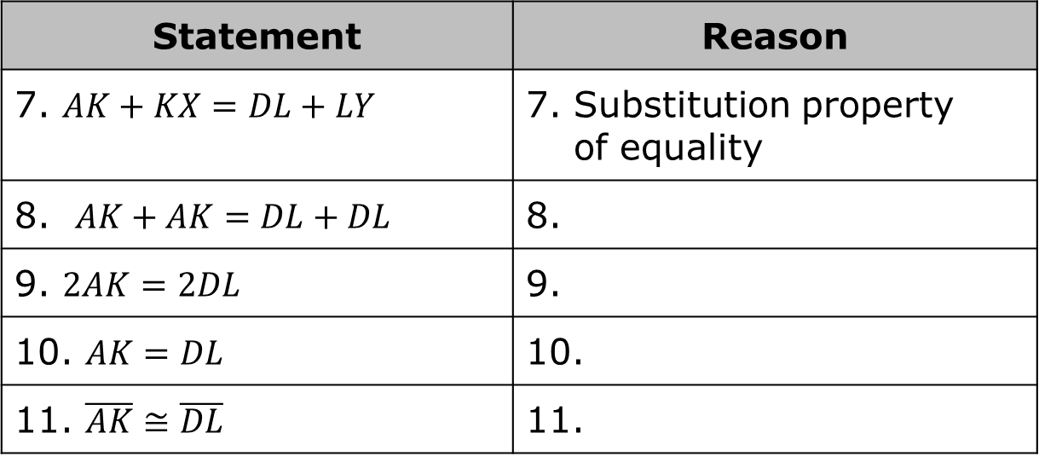
Statement | Reason
7. $AK+KX=DL+LY$ | 7. Substitution property of equality
8. $AK+AK=DL+DL$ | 8.
9. $2AK=2DL$ | 9.
10. $AK=DL$ | 10.
11. $\overline{AK}≅\overline{DL}$ | 11.
volume 1, pg. 120

Slide 21

Wrap-Up
volume 1, pg. 121

Slide 22
2.8.5 Wrap-Up: Reflection
Write a summary of what you learned in this lesson.
volume 1, pg. 121

